Slide 1
Chapter 4
Serial Communications

Slide 2
Serial Communications
Serial communications provide an easy and flexible way for your Arduino board to interact with your computer and other devices.
Serial communications are also a handy tool for debugging.
The debug messages can be sent from Arduino to the computer and display them on your computer screen or send them to another device such as a Raspberry Pi or another Arduino. You can also use an external LCD display to show these messages.
The Arduino IDE provides a Serial Monitor to display serial data sent from Arduino.
The data can be sent from the Serial Monitor to Arduino by entering text in the text box to the left of the Send button.
Arduino also includes a Serial Plotter that can graph serial data sent from Arduino

Slide 3
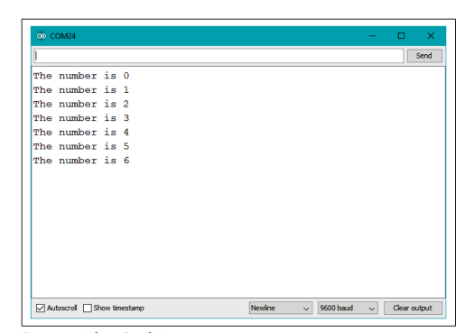
Serial Communications (contd.)
Figure 4-1. Arduino Serial Monitor screen

Slide 4
Serial Communications (contd.)
Serial.begin is used to set the speed of communication, in bits per second.
Serial connections send a start and stop bit to identify the start and end to a particular byte to the receiving system. Thus, 10 bits are needed to send one character.
Serial.begin(0) tells the Arduino that it should communicate with serial at 0 bits per second.
The default rate of 9,600 bits per second
Both Bit rate (BPS) and Baud rate are generally used in data communication,
Bit rate is the transmission of number of bits per second. On the other hand, Baud rate is defined as the number of signal units per second.
Bit rate = Baud rate x the number of bit per baud.

Slide 5
Serial Communications (contd.)
Arduino sketch can use the serial port to indirectly access all the resources (memory, screen, keyboard, mouse, network connectivity, etc.) that your computer has.
The computer can also use the serial link to interact with certain sensors or other devices connected to Arduino.
If you want to talk to multiple devices using serial communications, either you need more than one serial port or you’ll need to use software serial to emulate a serial port using Arduino pins

Slide 6
Serial Communications (contd.)
Implementing serial communications involves hardware and software.
The hardware provides the electrical signaling between Arduino and the device it is talking to.
The software uses the hardware to send bytes or bits that the connected hardware understands

Slide 7
Serial Hardware
Serial hardware sends and receives data as electrical pulses that represent sequential bits.
The zeros and ones that carry the information that makes up a byte can be represented in various ways.
The scheme used by Arduino is 0 volts to represent a bit value of 0, and 5 volts (or 3.3 volts) to represent a bit value of 1.
Level shifter or a voltage divider is used to avoid damaging the board.
Some boards (do no have USB) require an adapter for connecting to your computer that converts TTL to USB.

Slide 8
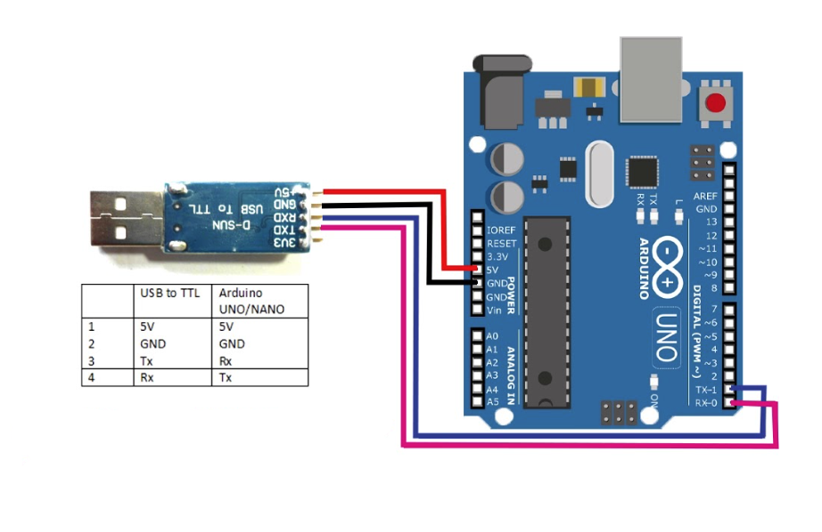
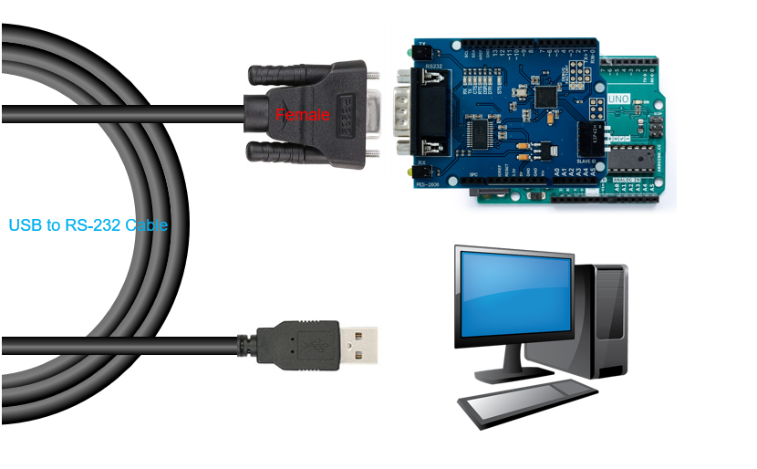
USB to TTL converter
RS 232 Cable

Slide 9
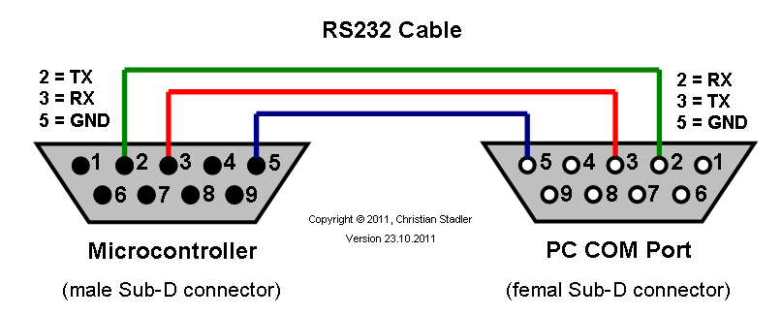
Serial Hardware (Contd.)
Some serial devices use the RS-232 standard for serial connection.
These usually have a nine-pin connector, and an adapter is required to use them with the Arduino.
RS-232 uses voltage levels that will damage Arduino digital pins, so you will need to obtain an RS-232 to TTL adapter to use it.

Slide 10
Serial Hardware (Contd.)
An Arduino Uno has a single hardware serial port, but serial communication is also possible using software libraries to emulate additional ports (communication channels) to provide connectivity to more than one device.
The Leonardo and many 32-bit boards have a second hardware serial port in addition to USB serial. The Teensy 3 board from PJRC has three serial ports in addition to USB serial. The Teensy 4.0 board has seven serial ports (in addition to USB serial).
The Arduino Mega has four hardware serial ports that can communicate with up to four different serial devices.

Slide 11
Serial Hardware (Contd.) – Message Protocol
The formal organization of information in a message and the range of appropriate responses to requests is called a communications protocol.
A protocol can be established over any underlying data transfer system, such as serial communications, but these same principles apply to other means of data transfer, such as Ethernet or WiFi networking.
Messages can contain one or more special characters that identify the start of the message—this is called the header.
One or more characters can also be used to identify the end of a message—this is called the footer.

Slide 12
Arduino Serial Notes
Serial.flush waits for the transmission of outgoing serial data to complete.
If you send a character, it is placed in a buffer for transmission. It takes time for each character to be sent because serial is slow. Once it is in the buffer, it will be sent automatically in the background while the program immediately moves on to the next statement. This is done so the program won't waste time waiting for characters to be sent. flush() is a way to wait for it to be sent, instead of immediately moving on in the user program. So after calling flush() you can be sure that all data has been sent, and the buffer is empty.
Serial.print will send data to the serial port in human-readable ASCII text.
Serial.write will send data in binary.

Slide 13
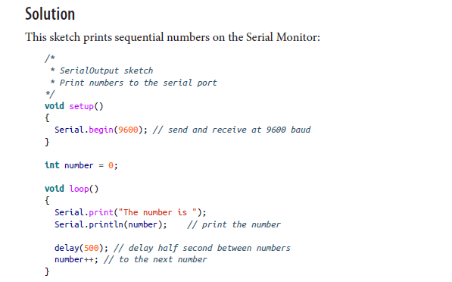

Sending Information from Arduino to Your Computer
Problem: You want to send text and data to be displayed on your PC, Mac, or other device (such as a Raspberry Pi) using the Arduino IDE or the serial terminal program of your choice

Slide 14
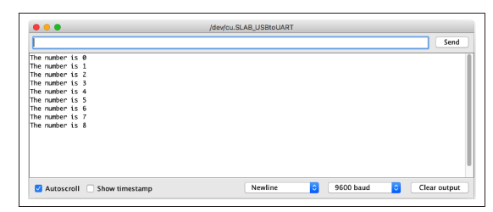
Sending Information from Arduino to Your Computer
Figure 4-2. Arduino Serial Monitor screen

Slide 15
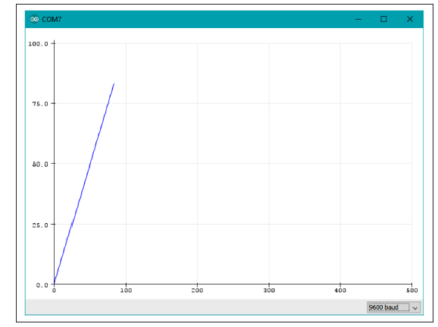
Sending Information from Arduino to Your Computer
To get a graphical display of the number being sent back, close the Serial Monitor window and Select Tools→Serial Plotter. A window will open and draw a graph of the values as they are received from the board. The plotter can isolate the numbers from the text, and identify multiple numbers separated by alpha characters and plot them separately using different color traces.
Figure 4-3. Serial Plotter

Slide 16
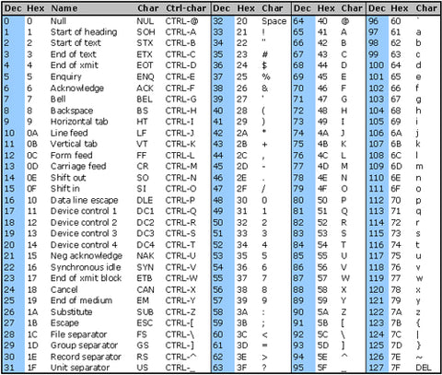
ASCII Table

Slide 17
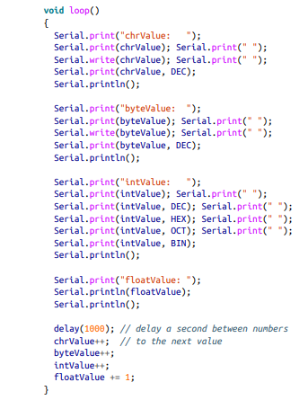



Sending Formatted Text and Numeric Data from Arduino
Want to send serial data from Arduino displayed as text, decimal values, hexadecimal, or binary

Slide 18
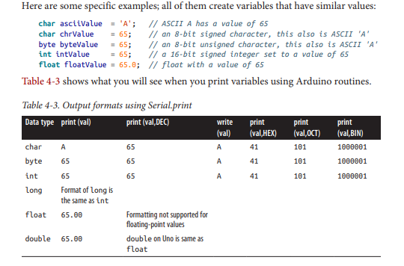

Slide 19
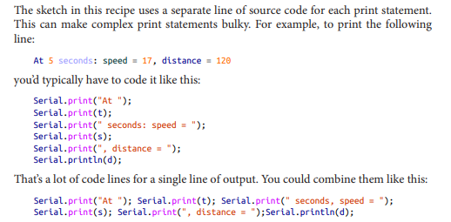

Slide 20
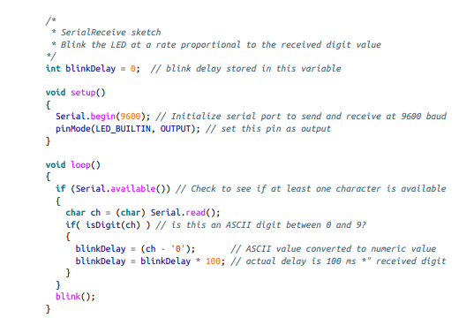
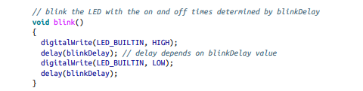
Receiving Serial Data in Arduino
Problem: Want to receive data on Arduino from a computer or another serial device; for example, to have Arduino react to commands or data sent from your computer.

Slide 21
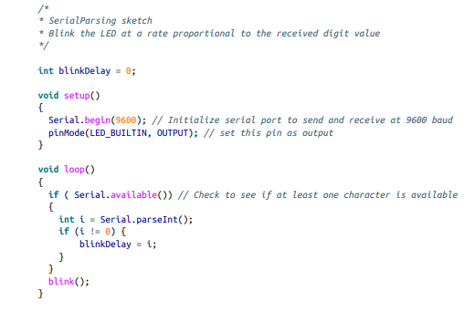
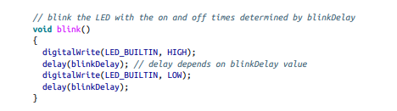
To receive numbers with more than one digit using the parse Int and parse Float methods that simplify extracting numeric values from Serial.
Serial.parseInt() and Serial.parseFloat() read Serial characters and return their numeric representation.
If there aren’t any numeric characters in the input, the functions return 0, so you should check for zero values and handle them appropriately.

Slide 22
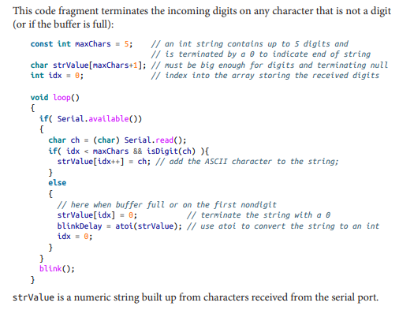
Another approach to converting text strings representing numbers is to use the C language conversion function called atoi (for int variables) or atol (for long variables). These obscurely named functions convert a string into integers or long integers.

Slide 23
To use these functions, you have to receive and store the entire string in a character array before you can call the conversion function.
atoi (short for ASCII to integer) is a function that converts a character string to an integer (atol converts to a long integer)
Arduino also supports the serialEvent function that you can use to handle incoming serial characters. If you have code within a serialEvent function in your sketch, this will be called once each time through the loop function

Slide 24
Receiving Multiple Text Fields in a Single Message in Arduino
Problem
You want to receive a message that contains more than one field. For example, your message may contain an identifier to indicate a particular device (such as a motor or other actuator) and what value (such as speed) to set it to.
Arduino does not have the split() function used in the Processing code.
Sketch uses the parseInt method that makes it easy to extract numeric values from serial and web streams.
parseInt ignores anything other than a minus sign and a digit, so it doesn’t have to be comma separated. You can use another delimiter like 1/2/3. The sketch stores the numbers in an array, and then prints them out, separated by commas.

Slide 25
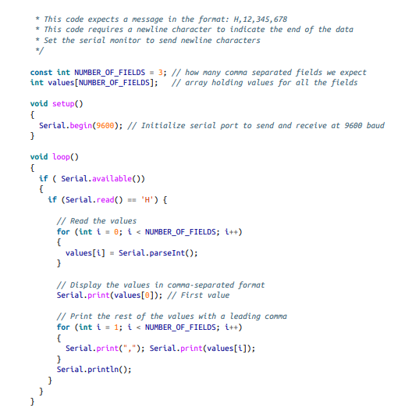

Slide 26
The stream-parsing functions will time out waiting for a character; the default is one second. If no digits have been received and parseInt times out, then it will return 0.
The timeout can be changed by calling Stream.setTimeout(timeoutPeriod). The timeout parameter is a long integer indicating the number of milliseconds, so the timeout range is from 1 ms to 2,147,483,647 ms.
bool find(char *target) : Reads from the stream until the given target is found. It returns true if the target string is found. A return of false means the data has not been found anywhere in the stream and that there is no more data available.
bool findUntil(char *target, char *terminate): Similar to the find method, but the search will stop if the terminate string is found. Returns true only if the target is found.
long parseInt(): Returns the first valid (long) integer value. Leading characters that are not digits or a minus sign are skipped. The integer is terminated by the first non digit character following the number. If no digits are found, the function returns 0

Slide 27
long parseInt(char skipChar); Same as parseInt, but the given skipChar within the numeric value is ignored.
float parseFloat(): The float version of parseInt. All characters except digits, a decimal point, or a leading minus sign are skipped.
size_t readBytes(char *buffer, size_t length): Puts the incoming characters into the given buffer until timeout or length characters have been read. Returns the number of characters placed in the buffer.
size_t readBytesUntil(char terminator, char *buf, size_t length): Puts the incoming characters into the given buffer until the terminator character is detected. Strings longer than the given length are truncated to fit. The function returns the number of characters placed in the buffer

Slide 28
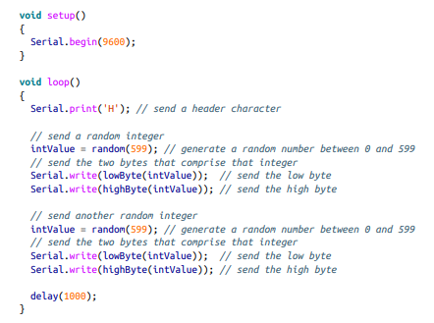

Sending Binary Data from Arduino
Problem: You need to send data in binary format, because you want to pass information with the fewest number of bytes or because the application you are connecting to only handles binary data.

Slide 29
Sending Binary Data from Arduino
Designing your messages so that the sending and receiving sides know exactly how many bytes are expected.
The end of a message is determined by the number of bytes sent rather than detection of a specific character
This can be implemented by sending an initial value to say how many bytes will follow. Or you can fix the size of the message so that it’s big enough to hold the data you want to send.
Different platforms and languages can use different sizes for the binary data types—both the number of bytes and their order may be different from Arduino. For example, Arduino defines an int as two bytes (16 bits) on 8-bit platforms, four bytes (32 bits) on a 32-bit platform, and Pro‐ cessing (Java) defines an int as four bytes (short is the Java type for a two-byte integer).

Slide 30

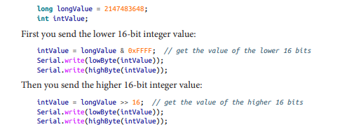
Example code using the Processing language to receive the messages.
To send an integer from Arduino you need to send the low and high bytes that make up the integer
Sending a long integer is done by breaking down the four bytes that comprise a long in two steps. The long is first broken into two 16-bit integers; each is then sent using the method for sending integers

Slide 31
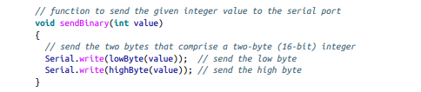


Example code using the Processing language to receive the messages.
Function that uses the code shown earlier to print a 16-bit integer to the serial port
Function sends the value of a long (four-byte) integer by first sending the two low (rightmost) bytes, followed by the high (leftmost) bytes:

Slide 32
Summay of important Points
Sending data as binary bytes is more efficient than sending data as text, but it will only work reliably if the sending and receiving sides agree exactly on the composition of the data.
Variable size: Make sure the size of the data being sent is the same on both sides. An integer is two bytes on Arduino Uno and other 8-bit boards, and four bytes on 32-bit boards and most other platforms.
Byte order: Make sure the bytes within an int or long are sent in the order expected by the receiving side. The solution uses the same byte order that Arduino boards use internally, called little endian. This refers to the order of the bytes, in which the least significant byte appears first.
Synchronization: Ensure that your receiving side can recognize the beginning and end of a mes‐ sage.
Flow control: Either choose a transmission speed that ensures that the receiving side can keep up with the sending side, or use some kind of flow control. Flow control is a handshake that tells the sending side that the receiver is ready to get more data.

Slide 33

Receiving Binary Data from Arduino on a Computer
Problem: You want to respond to binary data sent from Arduino in a programming language such as Processing.
Here, two lines of Processing code to read a byte, taken from the Processing SimpleRead example

Slide 34
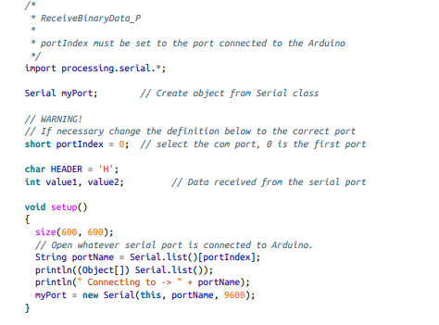
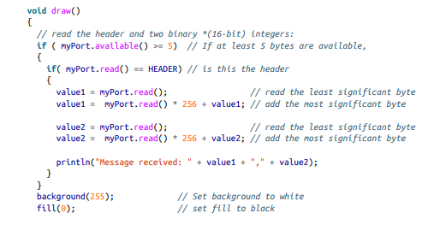

Processing sketch that sets the size of a rectangle proportional to the integer values received from the Arduino sketch

Slide 35
The setup function in Processing is used to handle one-time initialization, just like in Arduino. Processing has a display window, and setup sets its size to 600 × 600 pixels with the call to size(600,600).
The line String portName = Serial.list()[portIndex]; selects the serial port—in Processing
all available serial ports are contained in the Serial.list object, and this example uses the value of a variable called portIndex
println((Object[]) Serial.list()) prints all the available ports
Ensure that you set portIndex to the serial port that is connected to your Arduino
The draw function in Processing works like loop in Arduino; it is called repeatedly

Slide 36
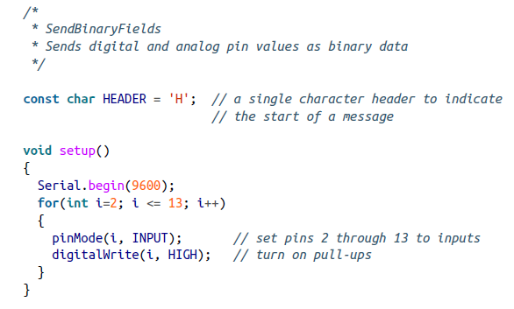
Sending the Values of Multiple Arduino Pins
Problem
You want to send groups of binary bytes, integers, or long values from Arduino. For example, you may want to send the values of the digital and analog pins to Processing.

Slide 37
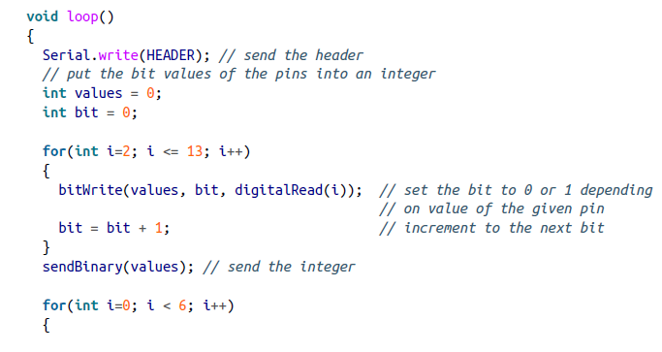
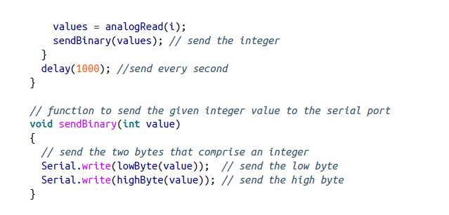

Slide 38
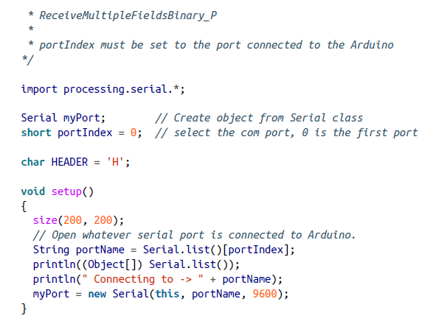
Processing code reads the message and prints the values to the Processing console:

Slide 39
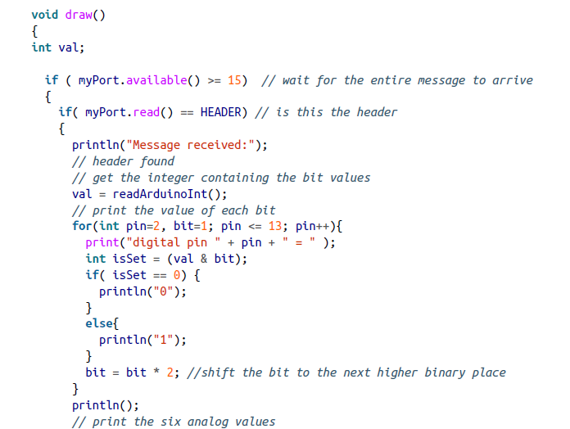
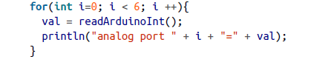
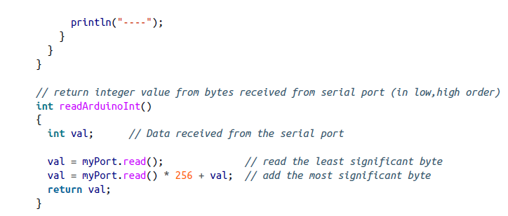
Processing code reads the message and prints the values to the Processing console:

Slide 40
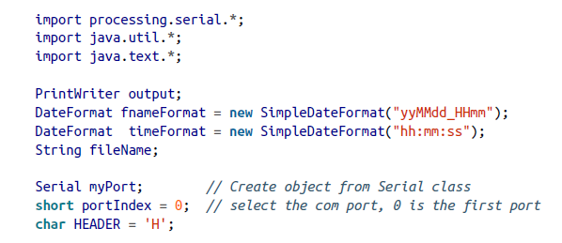
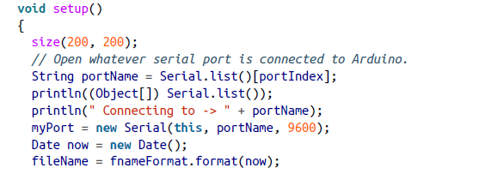

Logging Arduino Data to a File on Your Computer
Problem
You want to create a file containing information received over the serial port from Arduino. For example, you want to save the values of the digital and analog pins at regular intervals to a log file.

Slide 41
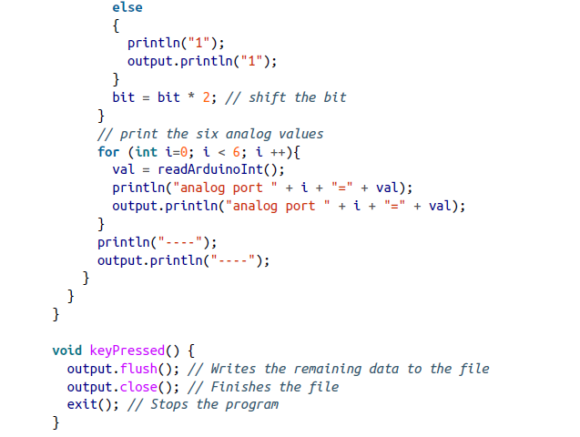
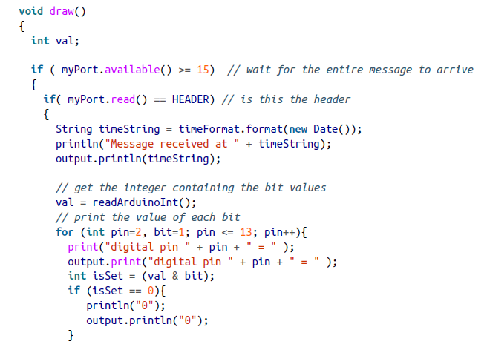
Logging Arduino Data to a File on Your Computer

Slide 42
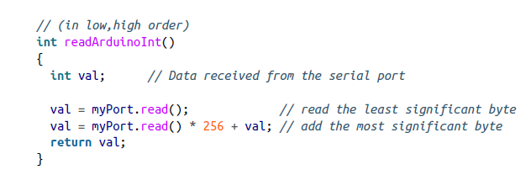

Slide 43
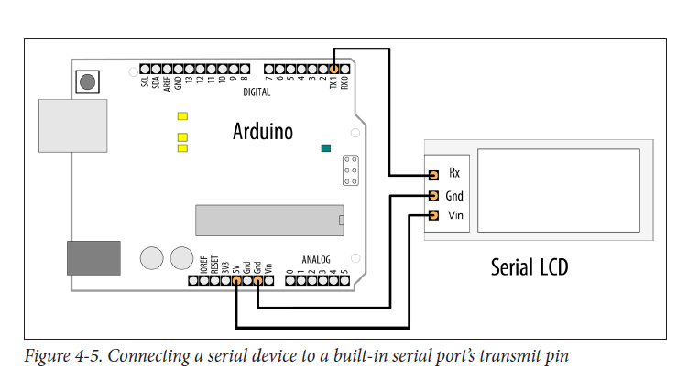
Sending Data to More than One Serial Device

Slide 44
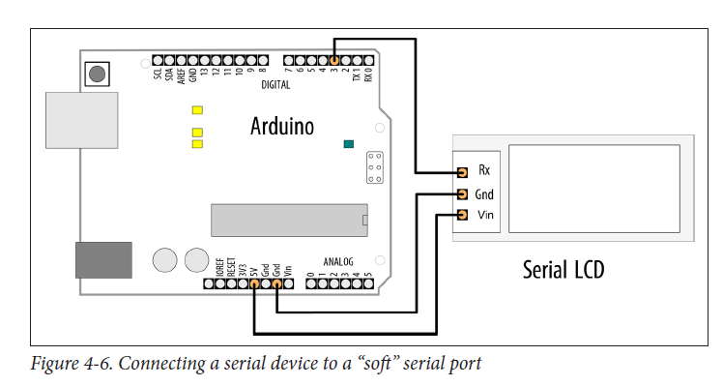
Sending Data to More than One Serial Device

Slide 45
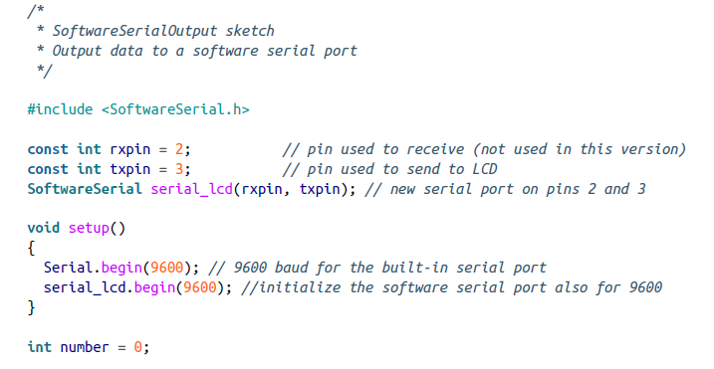
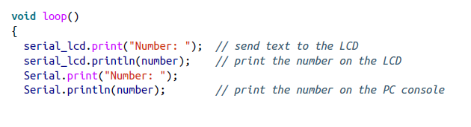

Sending Data to More than One Serial Device

Slide 46
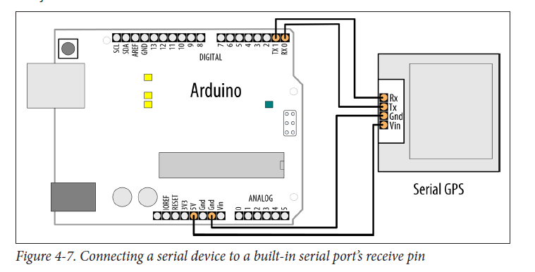
Receiving Serial Data from More than One Serial Device

Slide 47
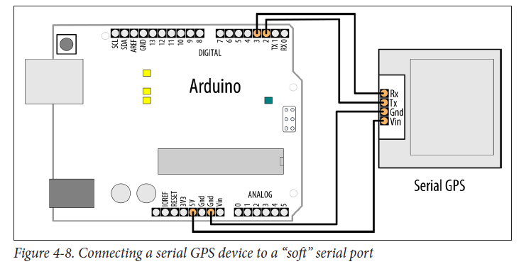
Receiving Serial Data from More than One Serial Device

Slide 48
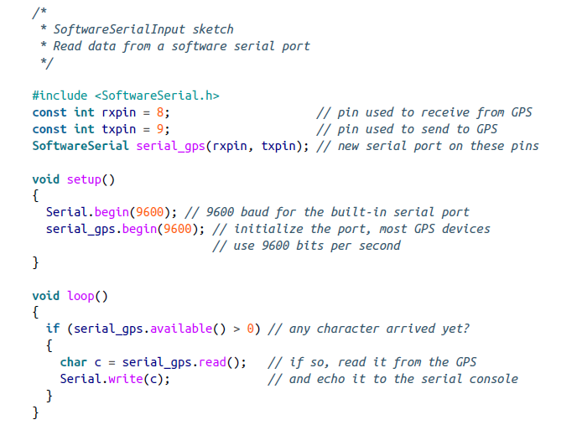
Receiving Serial Data from More than One Serial Device
This short sketch simply forwards all incoming data from the GPS to the Arduino Serial Monitor. If the GPS is functioning and your wiring is correct, you should see GPS data displayed on the Serial Monitor.

Slide 49
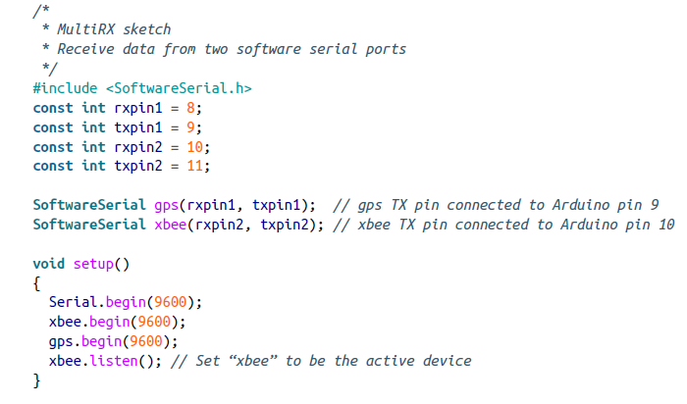
Receiving data from multiple Software Serial ports

Slide 50
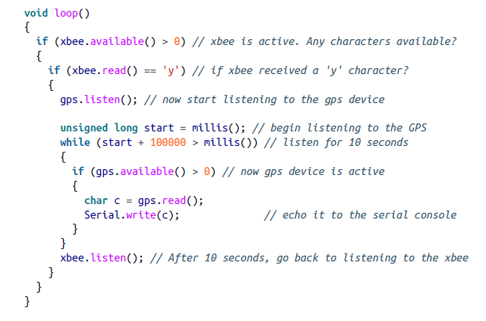
Receiving data from multiple Software Serial ports

